Slide 1
CC Math 6: Ratios & Proportions Unit 1

Slide 2
Purpose
Provided is a lesson for teachers to use to help students understand and understand unit rate. Included are the following resources:
Standards
Ratio and Proportion Learning Progression
Lesson Agenda
Getting Ready for the Lesson (Resources and Tips)
Vocabulary Activities
Lesson
(Presentation and Video)
Textbook Connections
Additional Resources
Notes:
Facilitator notes
Time: 2-3 minutes
Handouts/participant activity: n/a
Focus points:
Review the components that this PD provides:
Standards
Learning Progressions
Lesson Agenda
Resources & Tips
Vocabulary Activities
Lesson
Textbook Connections
Additional Resources

Slide 3
Common Core Standards
6.RP.3a. Use ratio and rate reasoning to solve real-world mathematical problems. Make tables of equivalent ratios relating to quantities with whole number measurements, find missing values in tables, and plot pairs of values in the coordinate plan. Use tables to compare ratios.
(Apply, 2) (Apply, 3) (Analyze, 3)
Notes:
Facilitator notes
Time: 2-3 minutes
Handouts/participant activity: n/a
Focus points:
Identifying the standards for lesson and unwrapping them.

Slide 4
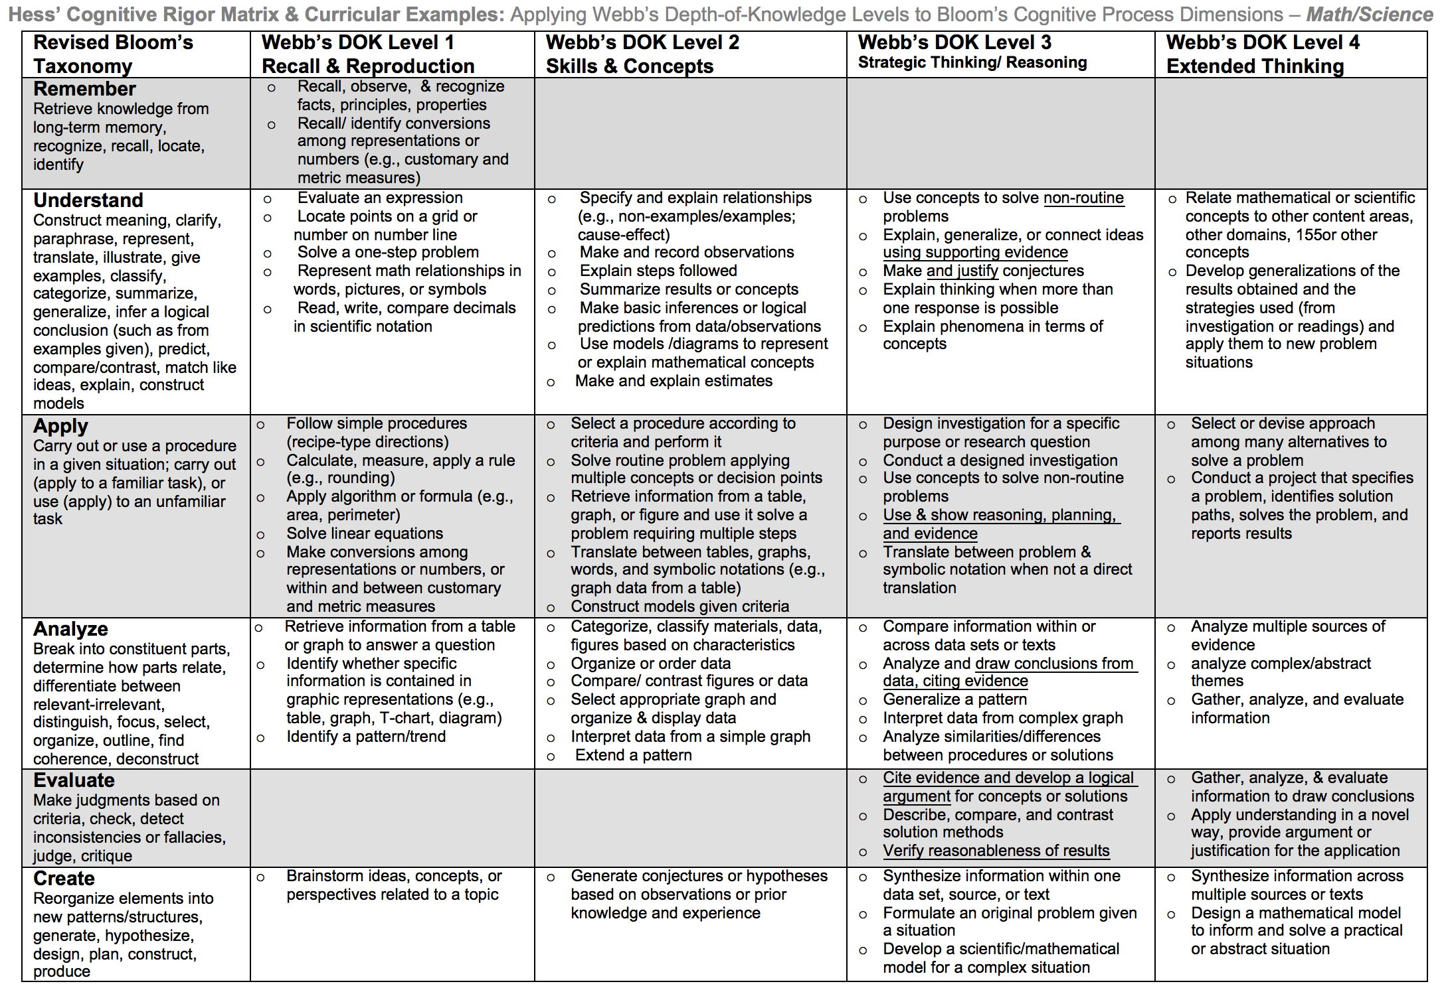
Notes:
Facilitator notes
Time: 2-3 minutes
Handouts/participant activity: n/a
Focus points:
Yellow, Red, & Green circles indicate the appropriate levels of DOK as required by the standards
The Blue circles fill in the instructional paths needed to assist students in reaching those DOK levels.

Slide 5
Math Practices
MP1
Make sense of problems and persevere in solving them.
MP8
Look for and express regularity in repeated reasoning.
Notes:
Facilitator notes
Time: 1-2 minutes
Handouts/participant activity: n/a
Focus points:
Review the math practices associated with the lesson being presented.

Slide 6
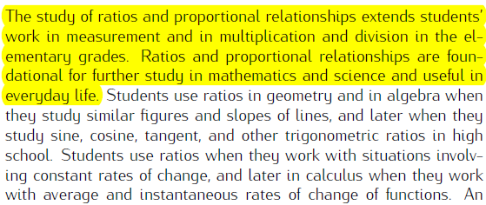
Ratio & Proportions Prerequisite Skills: CC Math 6
https://commoncoretools.files.wordpress.com/2012/02/ccss_progression_rp_67_2011_11_12_corrected.pdf
Notes:
Facilitator notes
Time: 2-3 minutes
Handouts/participant activity: n/a
Focus points:
Review the prerequisite skills the students completed prior to 6th grade and connect to what they will study during the CC Math 6 course.

Slide 7
Changes in Grade Level Standards
Grades K – 5th
Connecting standards
6th grade
New emphasis
Number sense strand redefined and broken into parts with some standards in the CC domain Ratio and Proportional Relationships
Algebra and Functions strand removed
No standard for converting fractions to percents
7th grade
New Emphasis- Every RP standard was previously taught in the 6th grade for CST
Calculate given percentages of quantities and solve problems involving discounts at sales, interest earned, and tips. (6th)
Use proportions to solve problems. Use cross-multiplication as a method for solving such problems. (6th)
Students analyze and use graphs, and rules to solve problems involving rates and proportions. (6th)
8th grade
New- Completely new course
Includes the domain, Functions
Excludes the domain, Ratio and Proportional Relationships
Source- http://commoncore.lacoe.edu/ccsesa/math.php
Notes:
Facilitator notes
Time: 2-3 minutes
Handouts/participant activity: n/a
Focus points:
There are major changes at each grade level with the domain of statistics and probability that have caused a shift in standards from CST time to Common Core Standards
Major points- Statistics and probability are no longer in Grades K – 5. Standards have switched between the 6th and 7th grade. There is also a completely new course for 8th grade students, which is CC Math 8. Therefore, the are now standards that were shifted from CST courses and into this new Common Core Course.

Slide 8
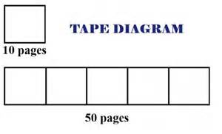
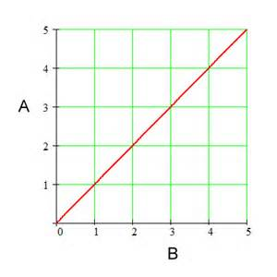
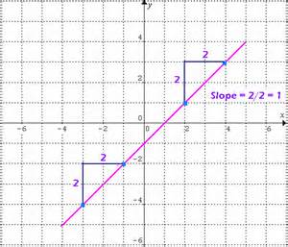
Middle School Focus
Grade 6
Understand ratio concepts and use ratio reasoning to solve problems.
Includes percent ratio and converting units of measurements
Note: Suggested strategies include ratio tables, tape diagrams, double number line or equation.
Grade 7
Analyze proportional relationships and use them to solve real-world and mathematical problems.
Compare unit rates
Decide if a relationship is proportional
Identify the constant of proportionality
Use proportional relationships with percents
Note: Required to do this with tables, graphs, diagrams and equations (y=kx)
Grade 8
Expressions and Equations
Understand the connection between proportional relationships, lines, and linear equations.
Unit rate defined as slope
Derive the equation
Functions
Use functions to model relationships between quantities.
Source - California Framework
Notes:
2 – 3 minutes
Facilitator’s Notes:
What are those standards that you must focus on and which ones are not part of your course with the new shifts in standard under common core?
Grade 6
Develop understanding of statistical variability.
Summarize and describe distributions.
Grade 7
Use random sampling to draw inferences about a population.
Draw informal comparative inferences about two populations.
Investigate chance processes and develop, use, and evaluate probability models.
Grade 8
Investigate patterns of association in bivariate data.
Let the participants know that they will use this handout in a later activity.

Slide 9
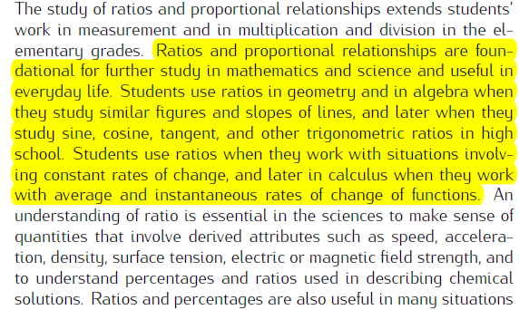
Learning Progression: Road to HS
https://commoncoretools.files.wordpress.com/2012/02/ccss_progression_rp_67_2011_11_12_corrected.pdf
Notes:
Facilitator notes
Time: 2-3 minutes
Handouts/participant activity: n/a
Focus points:
Let’s take closer look at the California Department of Education’s description of the CC Math 8 course.
Read the highlighted portion
The state framework shows the importance of the Grade 8 Math Course and how it has became the new gateway course for higher level math, as well as how Algebra 1 had shifted to high school.

Slide 10
Lesson Agenda
Vocabulary
Video: Understand and solve unit rate problems by using graphs of equivalent ratios
Lesson: New Cell Phone Task
Textbook Connections
Notes:
Facilitator notes
Time: 2-3 minutes
Handouts/participant activity: n/a
Focus points:
Review the lesson agenda prior to implementation

Slide 11
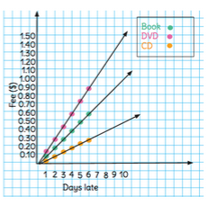
Core Lesson
Planning for Instruction with Unit Rate by Using Graphs of Equivalent Ratios
Notes:
Facilitator notes
Time: 1 minute
Handouts/participant activity: n/a
Focus points:
Title Page for lesson

Slide 12
Getting Ready
Pre-assessment- used to determine understanding of prerequisite skills
Prerequisite skills include
6 RP1
Understand the concept of a ratio and use ratio language to describe a ratio relationship between two quantities.
6 RP2
Understand the concept of a unit rate a/b associated with a ratio a:b with b ≠ 0, and use rate language in the context of a ratio relationship.
Source: http://curtismapper.pic.ucla.edu/MapApp/app/#/map
Notes:
Facilitator notes
Time: 2-3 minutes
Handouts/participant activity: n/a
Focus points:
Review what standards should be covered in a pre-assessment activity. This shows what students should have already learned prior to your course. Using a pre-assessment activity will assist students in frontloading prior knowledge before beginning new

Slide 13
Misconceptions and Anticipated Issues
Common Issues
Suggested Strategies/Resources
Thinking all points on the graph have to be at intersecting lines or that every number graphed has to be marked on the axes.
Misreading the slope on the graph as actual slope in real life.
Not finding unit rate
Use a whole-class discussion about the task, and share student approaches to describe patterns on the graph, as well as how it is marked.
Use a whole-class discussion to analyze the real-life interpretation of the steepness of the line.
Review vocabulary flip book, and discuss how unit rate answers the question how many (or how much) for 1.
Notes:
Facilitator notes
Time: 2-3 minutes
Handouts/participant activity: n/a
Focus points:
These are guided questions to improve our students’ learning when misconceptions may occur.
These are guided questions to improve our students’ learning.

Slide 14
Required Resources
Materials Required
Special Materials:
Graph paper for each student
Handouts:
Learnzillion presentation handouts
Learnzillion additional worksheets
https://learnzillion.com/lesson_plans/294-understand-and-solve-unit-rate-problems-by-using-graphs-of-equivalent-ratios
Notes:
Facilitator notes
Time: 2-3 minutes
Handouts/participant activity: n/a
Focus points:
Review the list of resources needed for the lesson and where to find materials online.

Slide 15
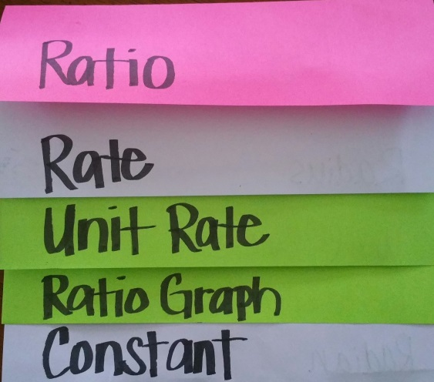
Needed Vocabulary
Rate
Unit Rate
Ratio
Ratio Graph
Constant
Alternative tools:
Word Map, Frayer Model, etc.
Layered Book Example
Notes:
Facilitator notes
Time: 4-5 minutes
Handouts/participant activity: n/a
Focus points:
This shows a list of required academic language vocabulary that is needed for the lesson. In addition, a strategy, “Layered Book” is shown with the suggestion that there are alternative strategies that can be used as well.

Slide 16
Learnzillion
For this lesson you need to create an account to access the handouts from Learnzillion.
This is a free account and you will have access to many more lessons.
Notes:
Facilitator notes
Time: 4-5 minutes
Handouts/participant activity: n/a
Focus points:
This is an introduction to the Learnzillion.com website where today’s lesson was pulled from. Teachers can sign up for a free account and have full access.

Slide 17
Understand and solve unit rate problems by using graphs of equivalent ratios
https://learnzillion.com/lesson_plans/294-understand-and-solve-unit-rate-problems-by-using-graphs-of-equivalent-ratios
Notes:
Facilitator notes
Time: 15 - 20 minutes
Handouts/participant activity: n/a
Focus points:
Click on the hyper link to take you to the lesson. Lesson includes: PowerPoint, Video, and handouts. As a department, we will explore this resources together

Slide 18
Planning and Time
Activities | Time | Notes
Preparation | 2 hours | Includes creating a pre-assessment, making copies, obtaining materials
Pre-lessons | 2 hours | Review of 6th grade RP standards
Vocabulary | 1 hour | Defining Ratio, Rate, Unit Rate, Graph, Constant
Cell Phone Task-Lesson | 2 hours | Explanation and completion of work
Practice and Additional Tasks | 2 hours | Additional worksheets from LearnZillion, Textbook practice, Illustrative Mathematics Tasks
Total Time | 9 hours
Notes:
Facilitator notes
Time: 1 - 2 minutes
Handouts/participant activity: n/a
Focus points:
Suggested pacing for this lesson

Slide 19
Textbook Connection: California Math
Textbook Course 1 Section 1.5
Classwork: Pages 48-49, problems 1 – 5
Homework: Page 51-53, problems 1 - 15
Extra Practice: Course 1 Resources by Chapter Section 1.5
Lesson 5 HW Practice
Lesson 5 Extra Practice: Graphing Ratio Tables
Student Re-teaching Section 1.5
Re-teaching: Graphing Ratio Tables
Assessment Book Course 1 Section 1.5
Self-Check Quick 1.5
Notes:
Facilitator notes
Time: 1-2 minutes
Handouts/participant activity: n/a
Focus points:
Connections to the California Math textbook for this specific standard / concept. As a department we may want to review this as well to compare to the Learnzillion lesson.

Slide 20
Additional Resources
Illustrative Mathematics - www.illustrativemathematics.com
Speed Conversions
Exam Scores
Which Detergent is a Better Buy?
Khan Academy - www.khanacademy.org
Engage NY Common Core Curriculum
Grade 6 Math Module 1, Topic C, Lesson 20
https://www.engageny.org/resource/grade-6-mathematics-module-1-topic-c-lesson-20
Notes:
Facilitator notes
Time: 3 - 4 minutes
Handouts/participant activity: n/a
Focus points:
This is a list of additional resources surrounding the standards that may be used. If time permits, as a department, explore these sites.

Slide 21
Textbook Connection: Go Math
Lesson 7.1: Ratios, Rates, Tables and Graphs
Classwork Page 176, Problems 1 – 6
Homework Page 177-178, Problems 7-17
Notes:
Facilitator notes
Time: 1-2 minutes
Handouts/participant activity: n/a
Focus points:
Connections to the Go Math textbook for this specific standard / concept. As a department we may want to review this as well to compare to the Learnzillion lesson.

Slide 22
Textbook Connection CPM
7.1.3 How Can I Find the Rate?
Classwork, Pages 646-648
Homework, pages 649-650
Notes:
Facilitator notes
Time: 1-2 minutes
Handouts/participant activity: n/a
Focus points:
Connections to the CPM textbook for this specific standard / concept. As a department we may want to review this as well to compare to the Learnzillion lesson.

Slide 23
Need Help?
Contact your
Secondary Math Coordinator

